Slide 1
Rock your School 2022

Slide 2
Background
-Reflection on Last Year -Created Committees -We have selected a Theme -Date is Friday, November 18th, 2022

Slide 3
Intentional Learning Plan
Rock your School is a day to take learning to the next level. Teachers will be required to tie in standards to the activities that have planned around the school theme.

Slide 4
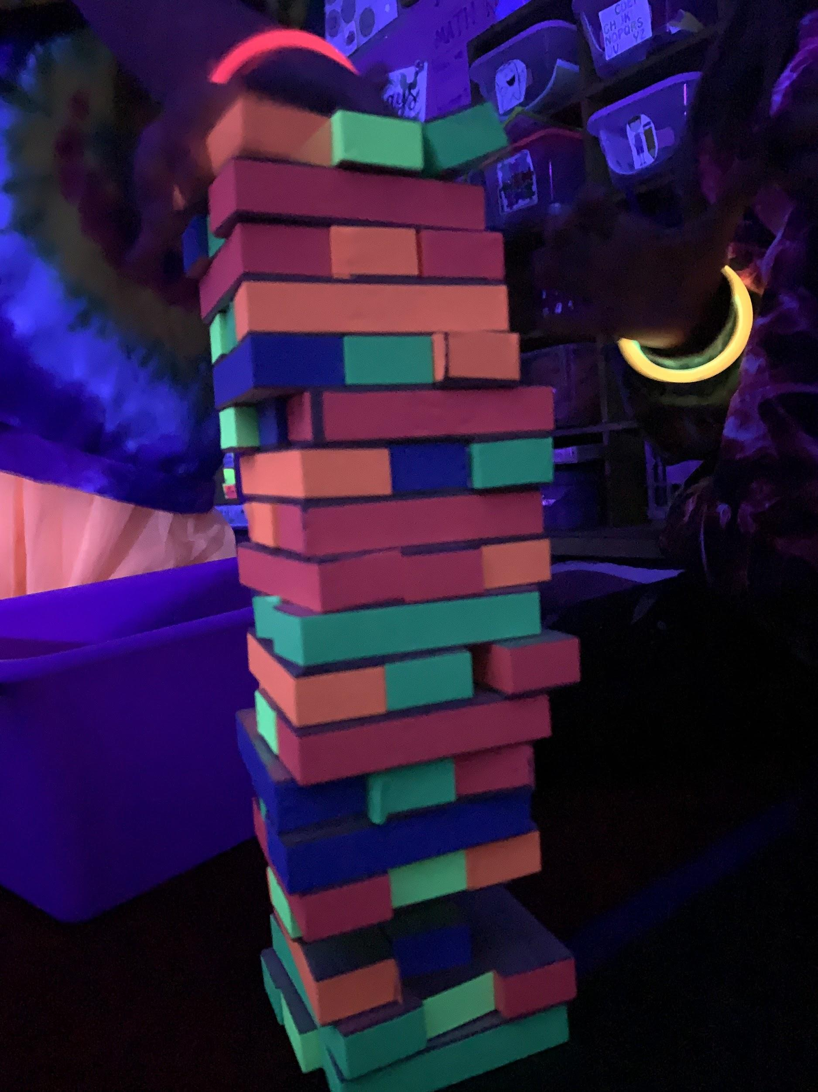
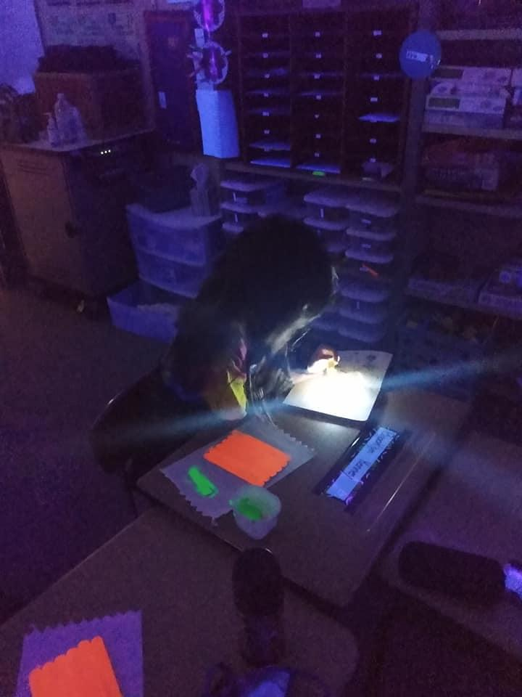
Intentional Learning Plan
RF.1.3.
Know and apply grade level phonics and word analysis skills in decoding words.
RF.1.4.
Read with sufficient accuracy and fluency to support comprehension.

Slide 5
Goal: $8,500
We are building up our inventory. Our dream to is have a four year rotation put into place.
$819.50 left from last year.
Summer Fundraising
Planning with action teams.
Updates and fall fundraising if needed

Slide 6
Back to School Bash
Kids get to meet teachers! (Maybe tie to Meet your Teacher Night so that is is only ONE night. Volunteers to help run the areas after Meet your Teacher Night 6:30-8.
We would like to host a Back to School Bash.
-Inflatables and carnival like games throughout the school.
=Food Trucks
Pricing:
Individual Tickets- $1 a piece
Wrist Band- $10
Keeping in mind our community: Overbrook Fair Carnival is August 11-13.
While subject to change, we want to have a positive and upbeat start to our school year!

Slide 7
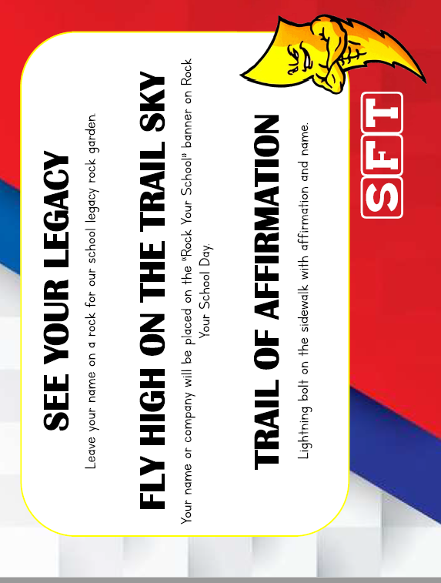
SFT Fundraiser
We are planning on setting up a booth during the Overbrook Fair to fundraise and inform the community about this positive day.

Slide 8
Thank you!

